Slide 1

My Research
Blaine Swieder 10/13/2025

Slide 2

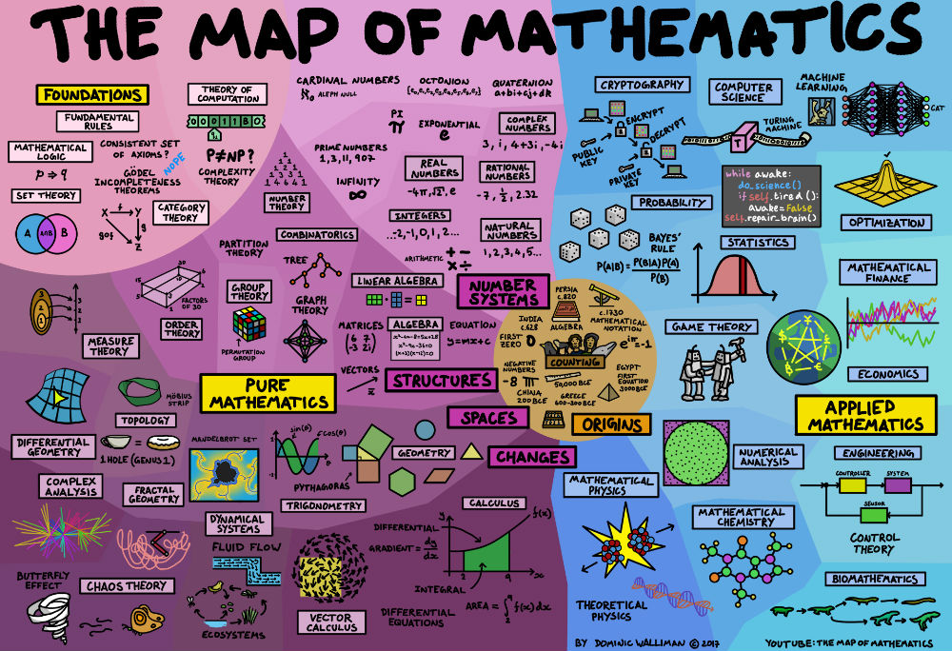
My Background
MSc in Electrical & Computer Engineering
BSc in Mathematics
BA in Foreign Languages

Slide 3
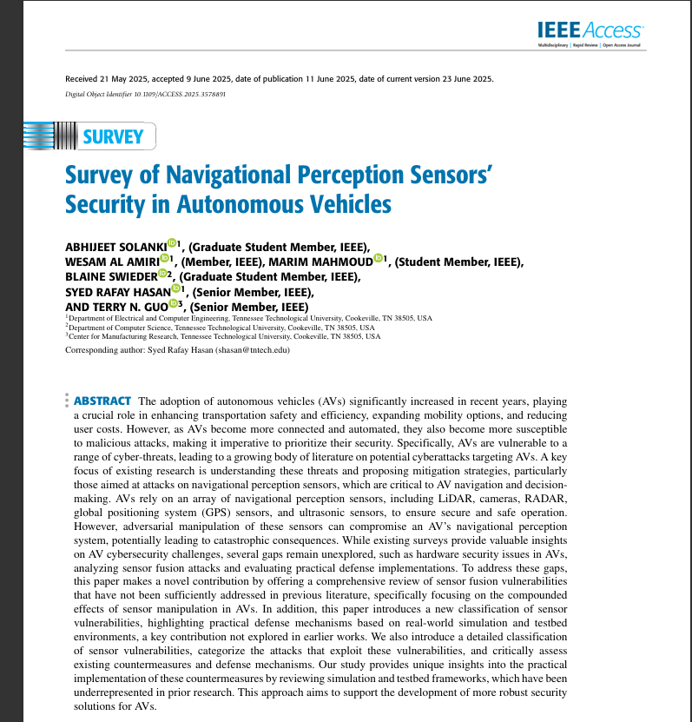
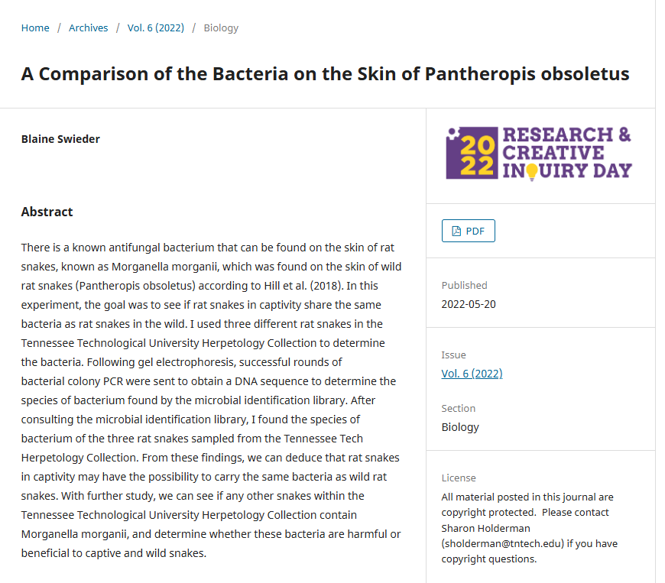
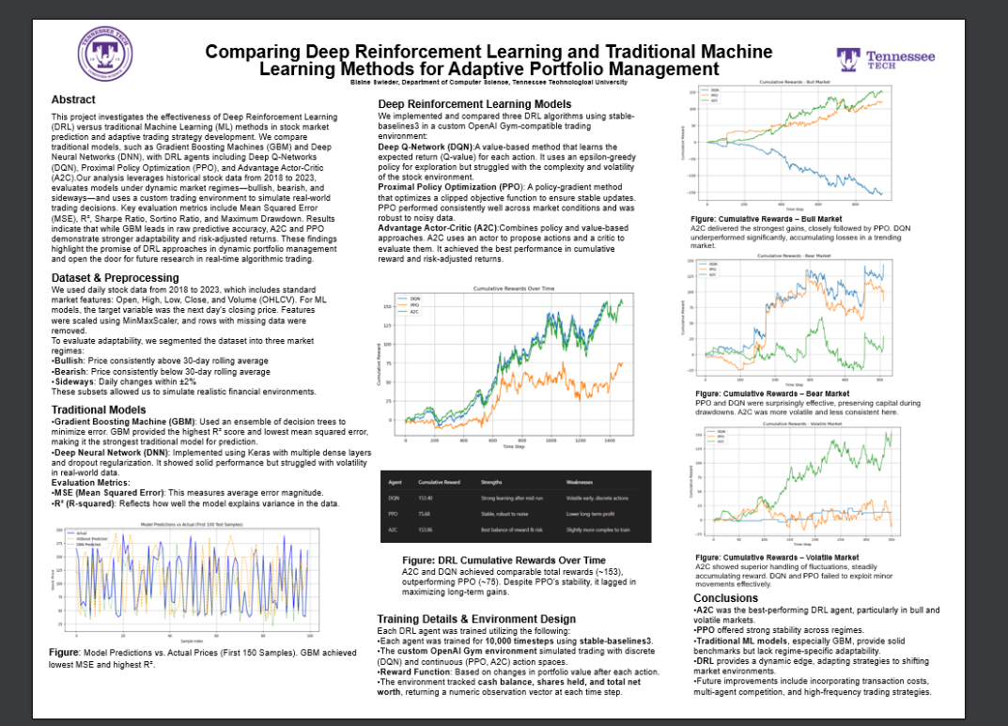
Previous Research Experience

Slide 4
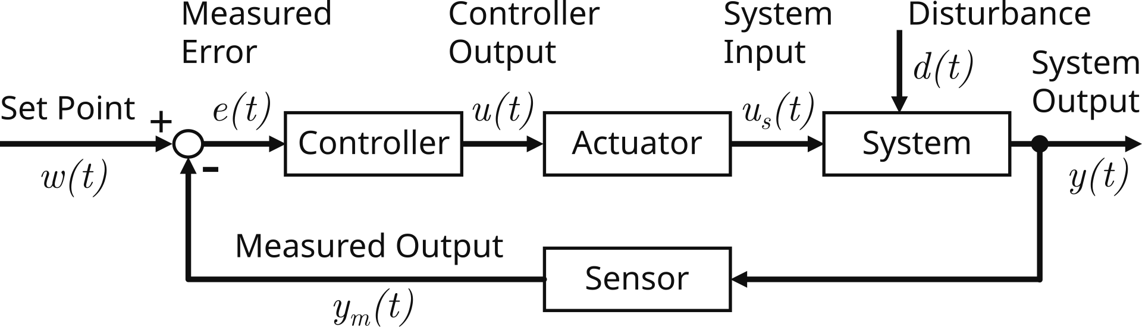
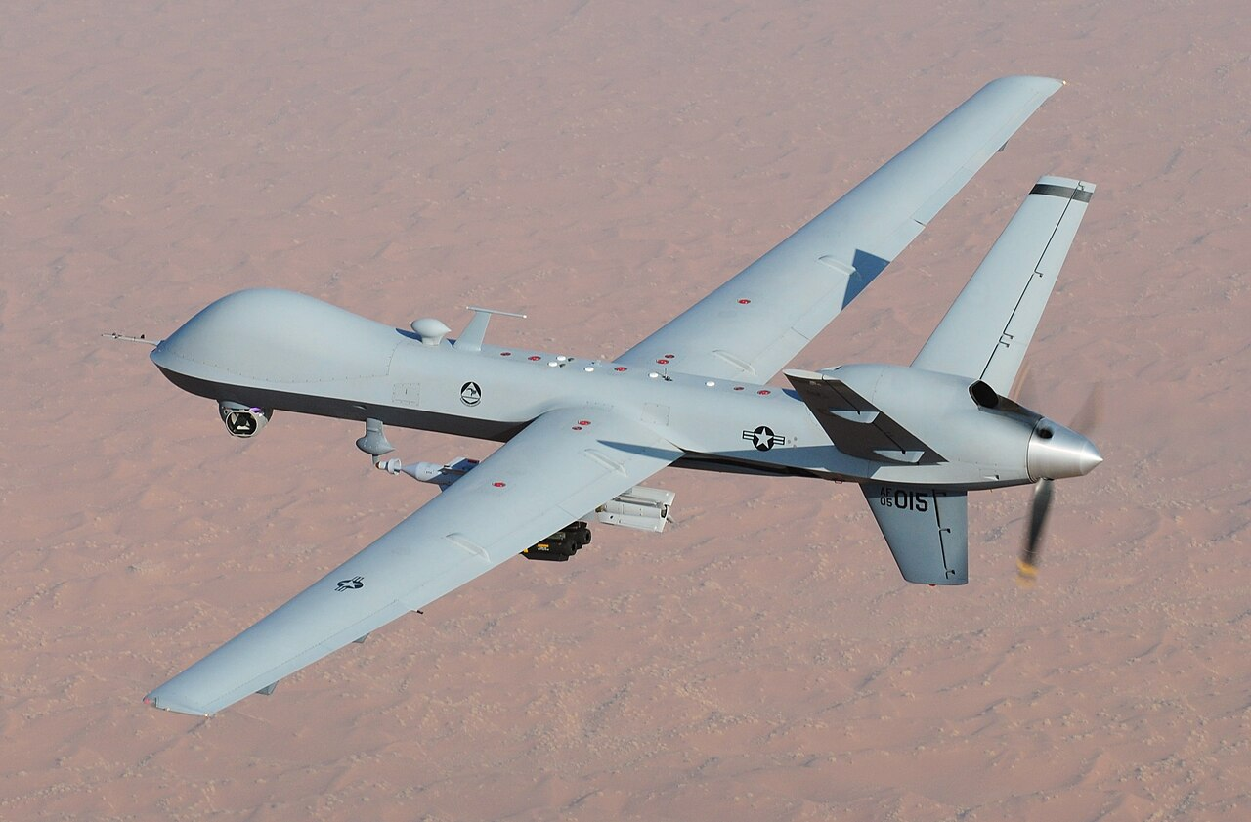
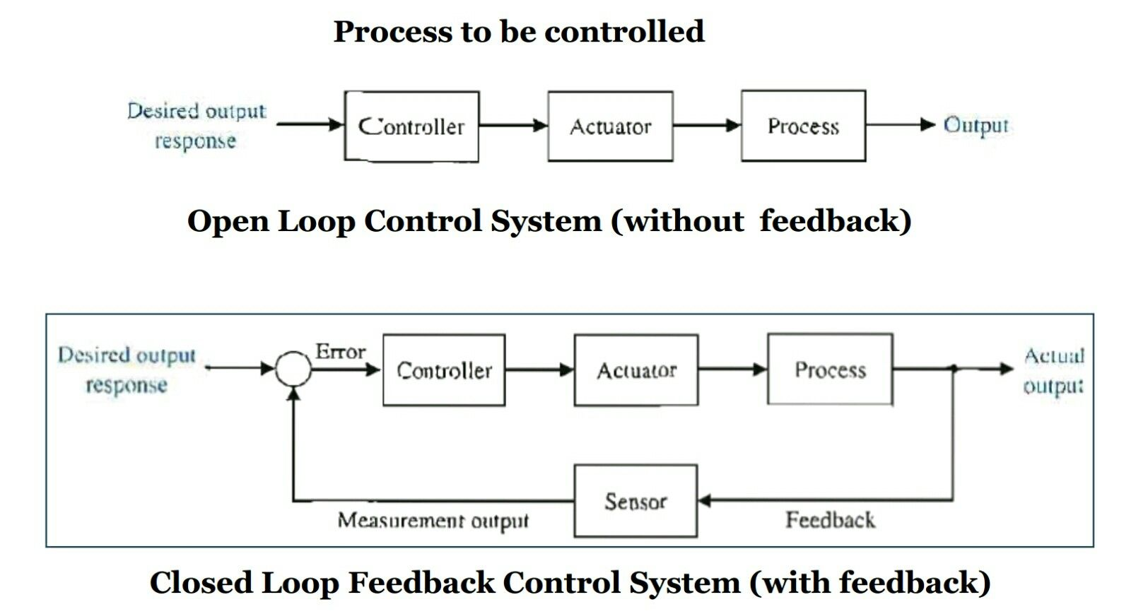
Current Research & Thesis Goals
Control Theory & Systems
Dynamical Systems
AI for ECE & AE

Slide 5
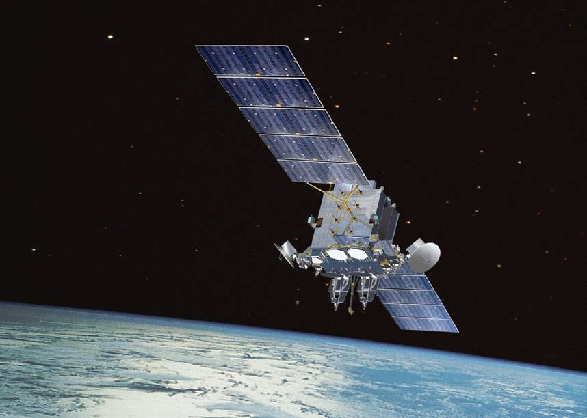
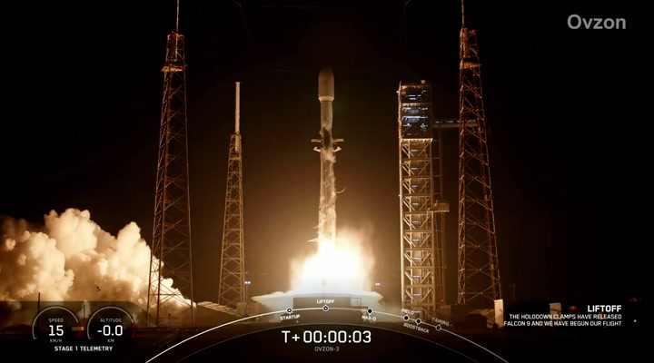


PhD Direction & Vision
PhD in Aerospace Engineering ’29 or ’30
Orbital Mechanics, Astrodynamics, Control Systems
Solve debris problem

Slide 6




Summary
Specialize in Controls and AI
Solve the space debris problem.

